Slide 1

S. Anandha prakash
M.Thanush

Slide 2
UN SDG Goal
Topic name: Zero Hunger
Team member names : Anandha prakash,
Thanush
Registration number : URK20CS2103,
URK20CS2105
K-Mail : anandhaprakaksh@karunya.edu.in
thanushm@karunya.edu.in
GitHub Repository Link:
https://github.com/Anandhaprakashs03/ai-hackathon

Slide 3
TABLE OF CONTENTS
Problem Statement And Mapping With UN SDG
Solution Found And Dataset Used
Data Analysis And Model Building
Insights Gained And References Used

Slide 4
PROBLEM STATEMENT
To develop a model to analyze the nutrient composition of various foods and suggest healthier alternatives.

Slide 5
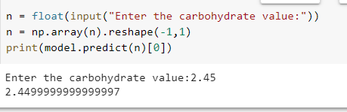
SOLUTION
How it will improve the current situation:
The nutrient value of food is almost always altered by the kind of
processing it undergoes. The water-soluble vitamins are the most
vulnerable to processing and cooking. Careful cooking and storage
will help retain the nutrients in your food.
Excessive consumption of ultra-processed foods can result in weight
gain in the short term and diet-related disease in the long term…
Comparison with existing models
Data science has become an increasingly important tool in the field of Zero Hunger, providing researchers and analysts with new ways to analyze data and make informed decisions.

Slide 6
DATASET USED
food_calorie_conversion_factor

Slide 7
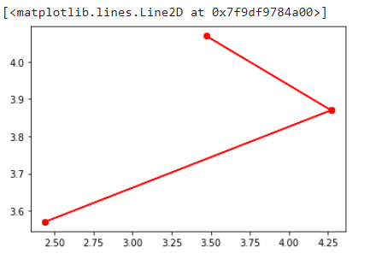
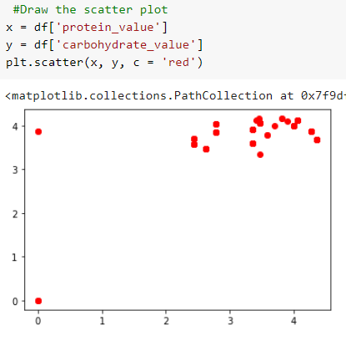
DATA VISUALIZATION
Data visualization involves representing data in graphical form, such as charts, graphs, and maps. Here are some ways data visualization is used in machine learning.

Slide 8
MODEL BUILDING
Training a dataset typically refers to the process of using an algorithm or machine learning model to learn patterns and relationships within a set of data, often referred to as the training data. This is done with the goal of being able to make accurate predictions or classifications on new, unseen data in the future.
In this project we have used Linear Regression which comes under Supervised learning algorithm.
Linear regression is a statistical model that is used to model the relationship between a dependent variable and one or more independent variables. The basic idea behind linear regression is to find the line of best fit that describes the relationship between the variables.

Slide 9
PERFORMANCE METRICS
Performance of a data model developed by data scientists is a direct way to measure their efficiency. Methods include confusion matrix, F1 score, Precision-Recall Curve, Receiver Operating Characteristics, among others. The idea is to see if the performance is better than the baseline models.
Accuracy: This is the most commonly used metric in classification problems, and measures the
proportion of correctly classified instances among all the instances in the test dataset.
Precision: This is a metric used to evaluate the performance of a classifier in identifying true positives and is calculated as the proportion of true positives among all positive predictions.
Recall: This is a metric used to evaluate the performance of a classifier in identifying all positive
instances, and is calculated as the proportion of true positives among all actual positives.

Slide 10
INSIGHTS GAINED AND REFERENCES USED
INSIGHTS GAINED:
• Patterns and trends in the data
• Key factors that drive certain outcomes or behaviors
• Insights into customer behavior or preferences
• Opportunities for optimization or improvement
REFERENCES:
• Data visualization tools such as Tableau or Power BI, which can help you visualize
your data and identify patterns.
• Libraries such as NumPy, Pandas.
• Online forums such as Kaggle

